Slide 1
ANGULAR

Slide 2
1.What is Angular?
Includes powerful features like:
o Two-way data binding
o Dependency Injection (DI)
o RxJS reactive programming
• Initial Version (AngularJS) released in 2010.
• Modern Angular (2+) rewritten and released in 2016.
• Angular is a TypeScript-based, open-source
frontend framework.
• Developed and maintained by Google.
• Used to build Single-Page Applications (SPAs).
• Follows a component-based architecture.

Slide 3
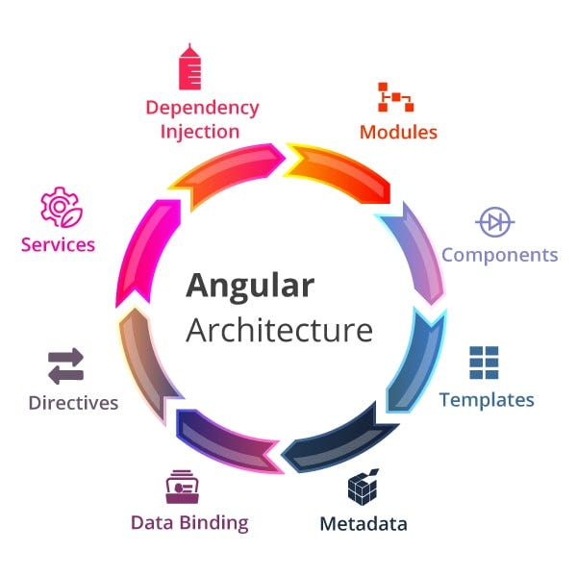
2.Angular Features
1. Component-Based Architecture
Angular applications are built using independent,
reusable components that manage their own logic,
template, and style.
2. Two-Way Data Binding
Keeps the model and view in sync automatically
without manually handling DOM events.
3. Dependency Injection (DI)
Angular injects services efficiently into components for
better modularity and testability.

Slide 4
2.Angular Features
4. Directives
Directives like *ngIf, *ngFor, and ngClass add dynamic
functionality to templates.
5. Angular Routing
Used to build SPA navigation without reloading pages.
6. TypeScript Support
Angular is built using TypeScript, offering static typing,
interfaces, and better tooling.

Slide 5
2.Angular Features
7. Forms (Template & Reactive)
Angular supports both simple template-driven forms
and powerful, scalable reactive forms.
8. Pipes
Pipes transform data directly in templates (e.g., date,
currency, uppercase).
9. Angular CLI
A robust command-line tool for generating files,
running servers, testing, and building production apps.

Slide 6
3.Angular Feature Summary
Features | Description
Components | Reusable UI building blocks
Directives | Modify DOM behavior and structure
Pipes | Transform output inside templates
Routing | SPA navigation without page reload
Services & DI | Share logic across components
Forms | Template-driven & reactive form handling
RxJS | Reactive programming support

Slide 7
4. Angular Setup
Step 1
Install Angular CLI
Step 2
Create a New Angular Project
Step 3
Run the Project
npm install -g @angular/cli
ng new app-name (Choose CSS and select No for server-side renderingwhen prompted)
cd app-name
ng serve (The application will run at: http://localhost:4200/ )

Slide 8
5.Angular Project Structure
Folder / File | Description
src/ | Main source folder containing the application code.
src/main.ts | Entry point of the application; bootstraps the root component.
src/index.html | Root HTML file; contains the <app-root> selector.
src/app/ | Contains all components, services, pipes, routes, and modules.
src/assets/ | Static files such as images, JSON data, and icons.
src/environments/ | Environment-specific configuration (e.g., development & production).
angular.json | Angular workspace configuration (build, serve, assets, styles).
package.json | Lists application dependencies and npm scripts.
tsconfig.json | TypeScript compiler configuration.

Slide 9
6. Basic Project Flow
Basic Project Flow
• main.ts → bootstraps AppComponent
• app.component.ts → main root component
• components/ → reusable UI parts
• services/ → shared logic & API calls
• routing → navigation setup
Potential Setup Issues
If you encounter PowerShell execution policy errors:
Set-ExecutionPolicy -Scope CurrentUser -
ExecutionPolicy RemoteSigned
Type yes when prompted.

Slide 10
5. Interview Questions and Answers
What is AngularJS?
AngularJS is an open-source, JavaScript-based front-end framework developed by Google to build dynamic single-page web applications (SPAs).
Why We Use AngularJS?
It provides two-way data binding and an MVC architecture, allowing developers to build responsive, single-page applications with reusable code.

Slide 11
Interview Questions and Answers
Features of Angular JS
Two-Way Data Binding: It automatically synchronizes data between the model and the view, meaning any change in the UI instantly updates the underlying data, and vice versa.
MVC Architecture: It separates the application into Model (data), View (UI), and Controller (logic), making code organized and easier to manage.
Directives: It extends standard HTML by adding custom attributes (like ng-model or ng-repeat), allowing you to create dynamic and reusable UI components.
Dependency Injection: It automatically supplies required objects or services to your components, making the application highly modular and much easier to test
Single Page Application (SPA) Routing: It loads a single web page and dynamically swaps out views as the user interacts, eliminating the need for slow page reloads.

Slide 12
6.Task
Install and create your first Angular Project

